Slide 1
Digital Portfolio
STUDENT NAME: KAVYA K C
REGISTER NO:2428B0092
NMID: B43114FF6F8F76094934EE62F6C3A5B7
DEPARTMENT: BSC CS DA
COLLEGE: SREE NARAYANA GURU COLLEGE

Slide 2
PROJECT TITLE
ONLINE PORTFOLIO WEBSITE FOR STUDENTS

Slide 3


AGENDA
Problem Statement
Project Overview
End Users
Tools and Technologies
Portfolio design and Layout
Features and Functionality
Results and Screenshots
Conclusion
Github Link
3/21/2024 Annual Review

Slide 4

PROBLEM STATEMENT Students often struggle to showcase their academic achievements, projects, skills, and certifications in a professional and organized manner. Traditional methods such as paper-based resumes or scattered digital files lack interactivity and accessibility. There is a need for an online portfolio platform where students can easily create, manage, and present their work to mentors, recruiters, and institutions in a structured and visually appealing format.

Slide 5

PROJECT OVERVIEW
The Online Portfolio Website for Students is a web-based platform designed to help students create and maintain a professional digital portfolio. It allows users to showcase their academic achievements, projects, certifications, and skills in an organized and visually appealing manner. The platform provides customizable templates, easy navigation, and mobile-friendly access to ensure that students can present their profiles effectively to mentors, recruiters, and educational institutions. By integrating features like project uploads, achievements display, and contact options, this platform serves as a one-stop solution for building a strong online presence.

Slide 6

WHO ARE THE END USERS? 1.Students 2.Teachers 3.Recruiters and Employers 4.Academic Institutions

Slide 7

TOOLS AND TECHNIQUES HTML CSS JavaScript

Slide 8
POTFOLIO DESIGN AND LAYOUT
Simple and responsive design.
Homepage with profile details and intro.
Projects and achievements showcased in a clean layout.
Mobile-friendly and easy navigation.
8

Slide 9
FEATURES AND FUNCTIONALITY
Easy login and signup for students.Add and update projects quickly.Upload certificates and achievements.Simple design with smooth navigation.Share your portfolio with one unique link.

Slide 10
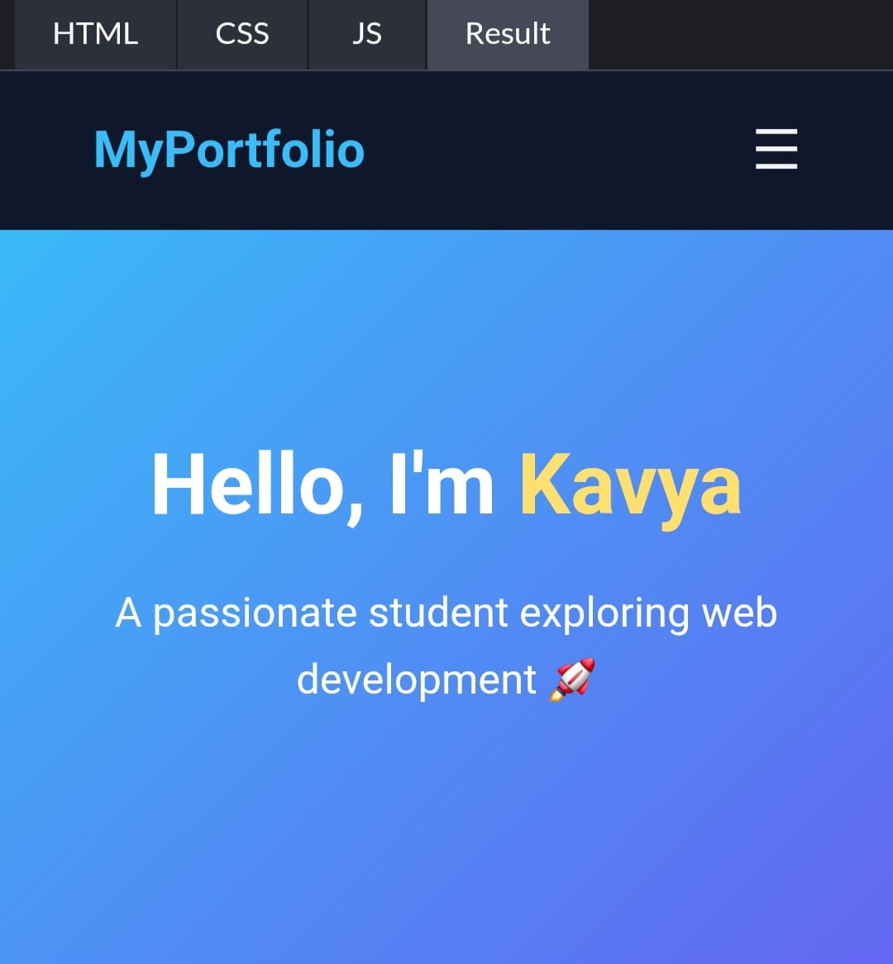

RESULTS AND SCREENSHOTS
3/21/2024 Annual Review
10

Slide 11
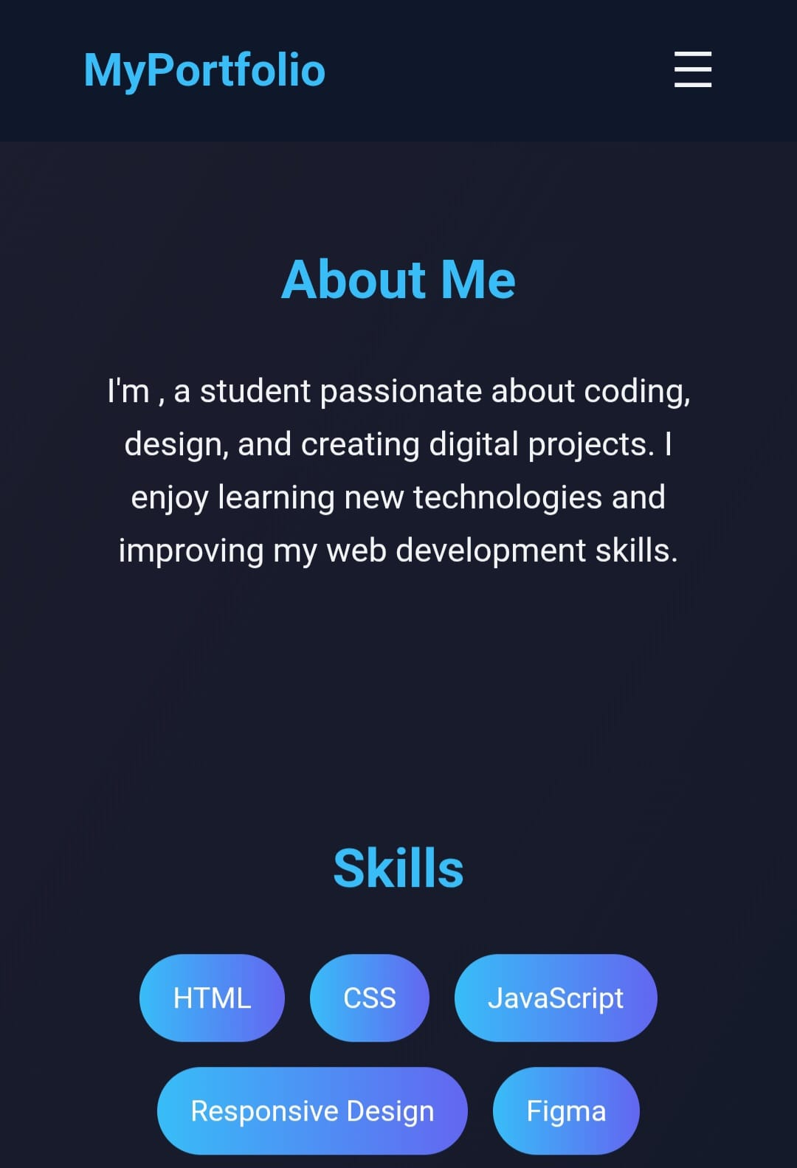

Slide 12
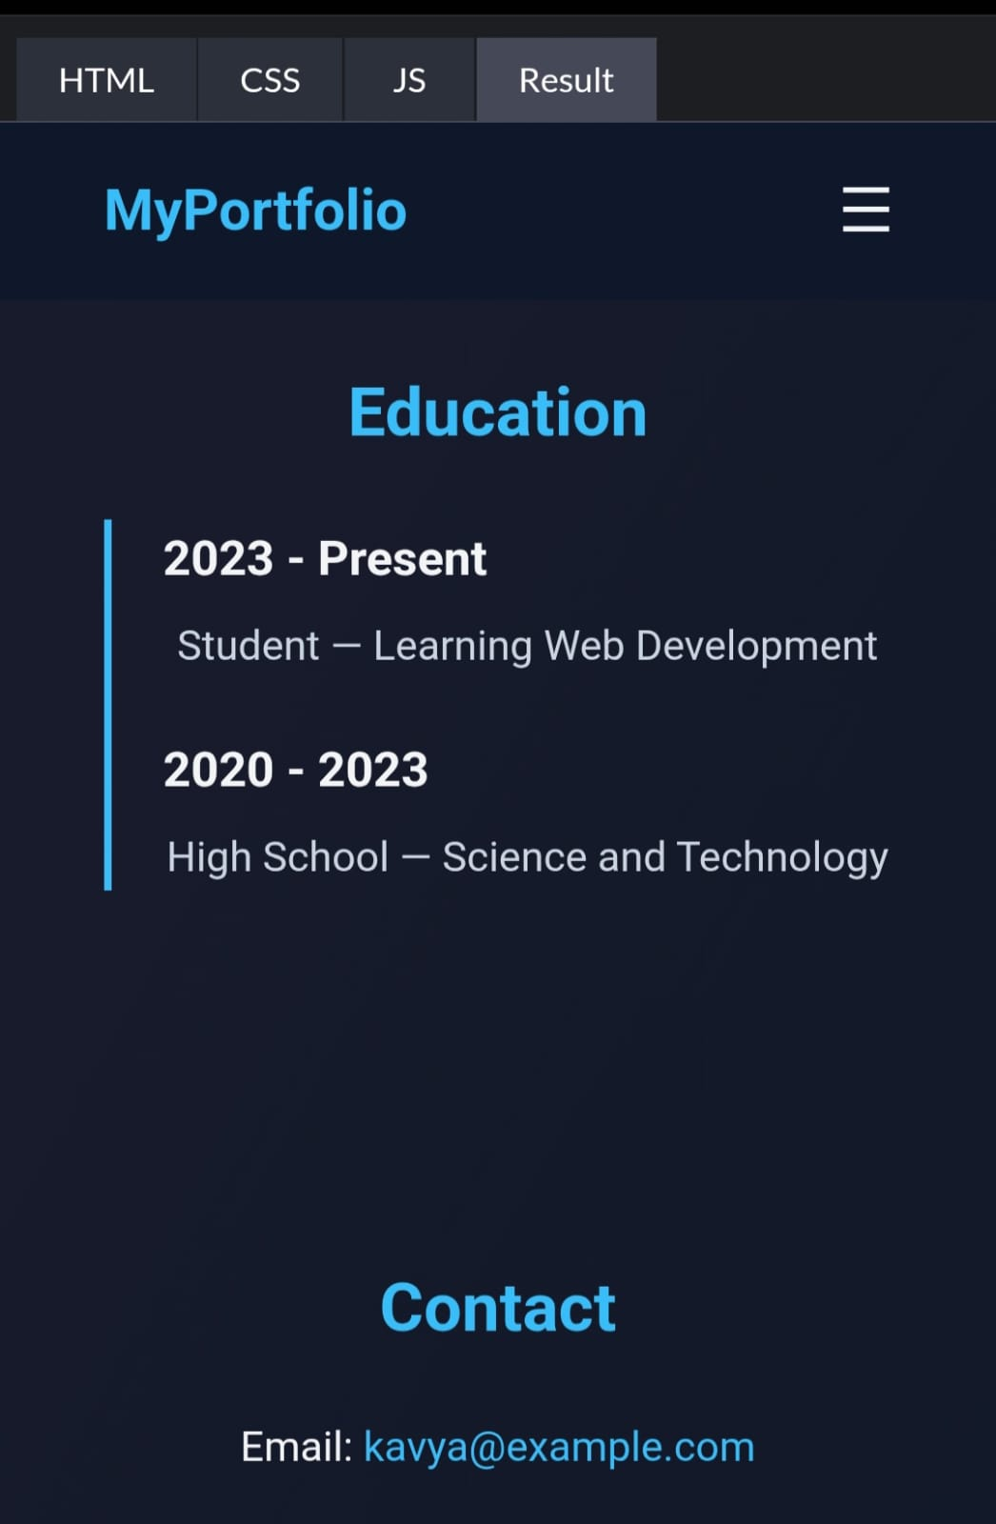

Slide 13
CONCLUSION
A digital portfolio using HTML, CSS, and JavaScript is a simple, responsive, and professional way to showcase projects, skills, education, and contact details in one place.
It makes sharing their work easier, improves their chances with recruiters, and provides a simple platform to manage everything in one place.
13

